Slide 1
Basics of AI and ML
ML.Net - Model Builder

Slide 2


Dinesh Kumar P
Product Manager,
Reports & Analytics Squad,
Notes:
Coming through 8+ years of journey around data space, I was deeply involved implementing B2B SaaS products for Big Data, ETL and Business Intelligence. Currently as a product manager, I take care of the analytics and reports squad at company called Kissflow. Here he would share his knowledge with his experience about his journey in data space and about the basics of AI and ML.

Slide 3

Agenda
My journey in Data Space.
Jobs around DATA.
What is Machine Learning?
Evolution of No code/ Low code platforms for ML.
Demo using ML.Net Model Builder.

Slide 5
What is Machine Learning ?
A program that looks for patterns in existing data.
Recognize those pattern in new data.

Slide 6
What Machine Learning does?
Predict Future.
Organize.
Group.
Simple examples like GMAIL is a best example:
-> Spam or not-Spam – Binary Text classification.
-> k-means clustering – Primary, Social, Promotion.

Slide 7
Features vs Labels
Features
Input
Labels
Output
Name, Amount, Where Issued, Age of Cardholder
Genuine/Fraud

Slide 8
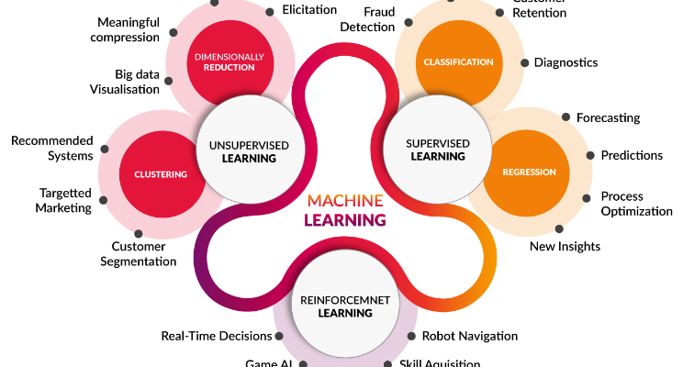
Algorithm - Types

Slide 9
Five Questions to cover algorithms
1. Is this A or B ?
2. Is this Weird ?
3. How much effective or many ?
4. How this should be organized ?
5. What should I do next ?
Notes:
Classification.
Anomaly Detection.
Regression.
Clustering.
Reinforcement.

Slide 10
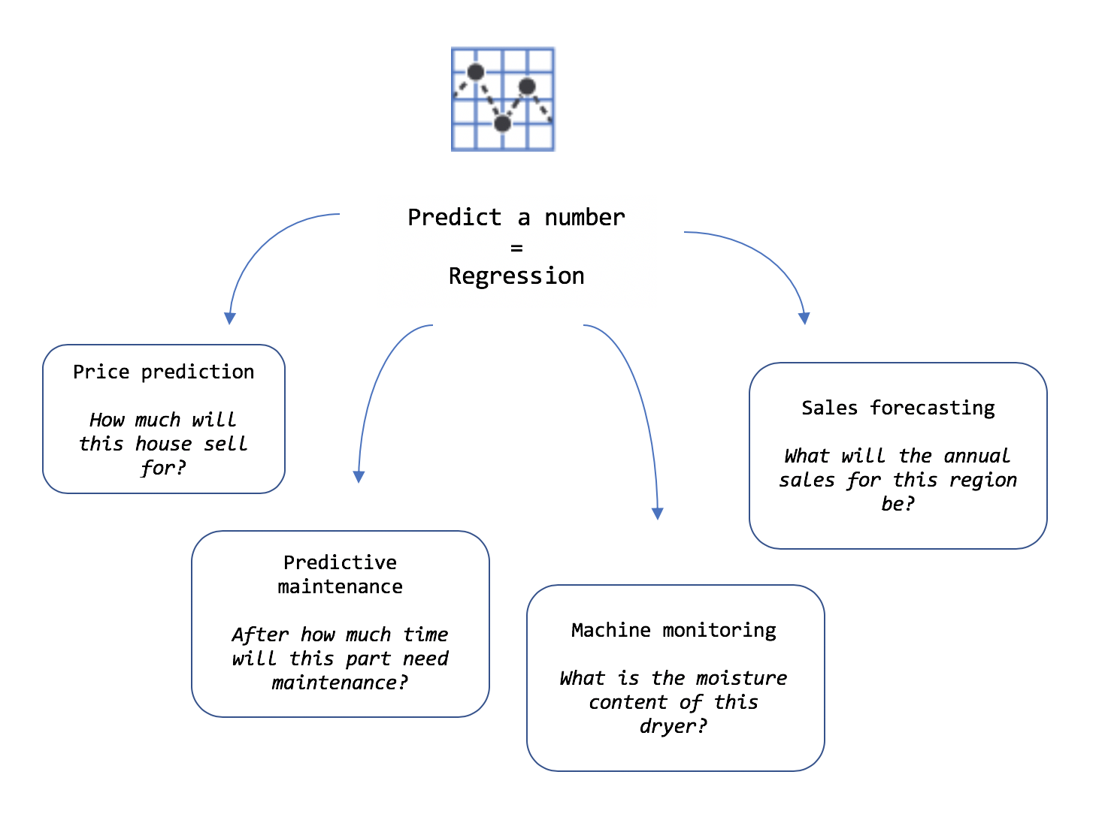
Clear about the requirement

Slide 11
Role of a Data Scientist
Data to use? Is there trained data already available?
How should that data be processed to create prepared data?
Identify Combinations of prepared data and machine learning algorithms should you use to create the best model?

Slide 12
ML.Net
Open source cross-platform machine learning framework.
Auto ML made easy to play via Model Builder with GUI.
Not required much expertise in ML.

Slide 13
If you know the problem well, figuring solution is as simple as it is.
Defining problem is 80%
Solution is just 20%

Slide 14
No/Low Code dev platforms
Problems better solvable by industry / business people like citizen data scientist.
DIY – Do It Yourself mindset.
Adobe Photoshop vs Canva.
Notes:
I hope you know tools like Canva. Such Tools are not so famous 10 years back. Late then, if any image editing work is needed, it was Photoshop and someone who learnt it very well is needed. But now, no code tool like Canva has made it possible to create a banner so easily. That's the case of ML.Net model builder as well. Currently the adoption to production environment is mostly on enterprise level. But in a while Machine Learning will become essential for any application.

Slide 15
Why no-code / low-code important for companies now?
Attain growth faster with small, lean & mobile workforce.
Fail fast.
Gartner predicts
65% of app development by the year 2024.
66% of companies would use 4 low-code tools & platforms.

Slide 16
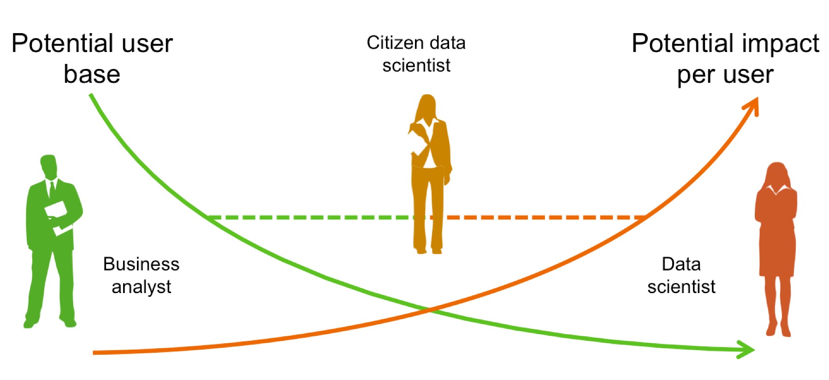
Model Builder – Who benefits the most
Notes:
Problem owners can drive the solution far better

Slide 17
Why own ML model matters?
Different businesses have different sense of data.
Specific problems relevant to individual business should be able to solve better by those business users.
Feedbacks of Movie, E-Commerce retail shopping website, Food ordering app may not be same type to categorize as good / bad.

Slide 18
My Use Case for ML.Net Model Builder
Goal: Recognize the sentiment of feedback text with 3 rating.
Reason: 1,2 rating mostly will have worst comment. Similarly 4,5 will have good comments. Feedbacks with 3 rating is annoying and yet to predict.

Slide 19
1. Train the model with same customer data with 1, 2, 4 and 5 ratings
2. Test the model
3. Use the model to check comments of 3 rating, where it fits in – 1, 2, 3 or 4
4. Pipeline to retrain the model in future

Slide 20
Do it Yourself

